Slide 1
State Management
Chapter 6

Slide 2
What Are You Going To Learn?
At the end of this lesson, you will be able to:
  Explain HTTP Protocol
  Differentiate cookie, query string, session variable, application variable and cache to retain information
  Use Global.asax file
  Choose and apply appropriate mechanism to maintain state

Slide 3
HTTP: HyperText Transfer Protocol
A communication protocol of the TCP/IP Suit with the Web server, used for retrieving hypertext.
The most common used protocol is HTTP/1.1
HTTP is a request/response standard between a client and a server.

Slide 4
HTTP: HyperText Transfer Protocol
Typically an HTTP client initiates a Request, which establishes a TCP connection to a particular port (usually port 80) on a host (server).
Upon receiving the request, the server sends back the requested resource as Response.
Resources to be accessed by HTTP are indentified using Uniform Resource Identifiers (URIs) (i.e. Uniform Resource Locator (URL) using the http: (or https:) URI schemes.

Slide 5
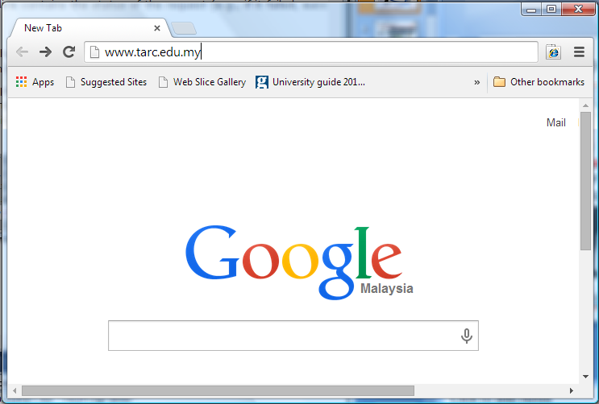
How HTTP works:
1
the user types in a Website’s URL into a browser (client)

Slide 6
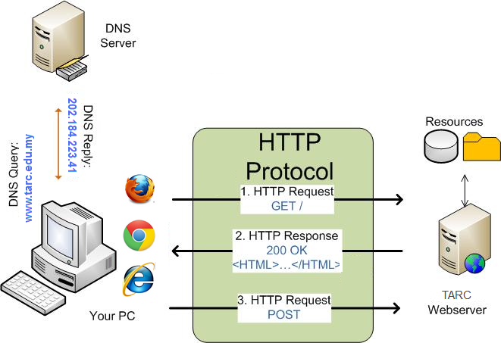
How HTTP works:
obtain IP address fro DNS services
2
establish TCP connection to the IP (on Port 80).
3

Slide 7
How HTTP works:
client’s packet (HTTP request) is transported to the server
GET /Index.html HTTP/1.1\r\n
Connection: Keep-Alive\r\n
Accept: */*\r\n User-Agent: Chrome/5.0 \r\n
Host: www.tarc.edu.my\r\n\r\n
4
Notes:
Note the first request contains the GET command. It requests the web server to provide the URL path '/'. It is followed by the HTTP version number: 1.1. The Host tag tells the web server which web site's '/' path is needed (This is important as more than one website is usually hosted on a single machine). The User-Agent tag gives the web server information about what browser you are using.

Slide 8
How HTTP works:
HTTP/1.1 200 OK
Server: Microsoft-IIS/5.0\r\n
Content-Location: http://www.tarc.edu.myindex.html\r\n
Date: Tue, 25 Jun 2002 19:33:18 GMT\r\n
Content-Type: text/html\r\n
5
the server then sends a HTTP response along with HTTP status code (e.g. 200 means OK, 404 means file not found)
Notes:
Note the first request contains the GET command. It requests the web server to provide the URL path '/'. It is followed by the HTTP version number: 1.1. The Host tag tells the web server which web site's '/' path is needed (This is important as more than one website is usually hosted on a single machine). The User-Agent tag gives the web server information about what browser you are using.

Slide 9

How HTTP works:
If the HTTP request is OK, the server will send the response contains the data requested in the body.
6
7
Once the response body has been transmitted, the HTTP server will be disconnected
Notes:
Note the first request contains the GET command. It requests the web server to provide the URL path '/'. It is followed by the HTTP version number: 1.1. The Host tag tells the web server which web site's '/' path is needed (This is important as more than one website is usually hosted on a single machine). The User-Agent tag gives the web server information about what browser you are using.

Slide 10
How HTTP works:
The subsequent request (of the same page) will be using POST method, to submit information to the server (e.g. submit enquiry)
POST/enquiry.asp HTTP/1.1\r\n
Connection: Keep-Alive\r\n
Accept: */*\r\n User-Agent: Chrome/5.0 \r\n
Host: www.tarc.edu.my\r\n\r\n
8
Notes:
Note the first request contains the GET command. It requests the web server to provide the URL path '/'. It is followed by the HTTP version number: 1.1. The Host tag tells the web server which web site's '/' path is needed (This is important as more than one website is usually hosted on a single machine). The User-Agent tag gives the web server information about what browser you are using.

Slide 11
What is state?
A program stores data in variables (memory locations). The contents of the memory locations at the given point in the program execution, is called state.
State refers to the current status of the properties, variables, and other data maintained by an application for a single user.
The application must maintain a separate state for each user.

Slide 12
HTTP is stateless
It doesn’t keep track of state between round trips.
Each request is standalone and considered a new request from a new user.
Once a browser makes a request that receives a response, the application terminates and its state is lost.

Slide 13
Client-side state management options
The following are the client-side state management options that ASP.NET supports:
  View state
  Control state
  Hidden fields
  Cookies
  Query strings
Notes:
View state can be disabled, but control state cannot.
Control state is used to store essential data that must be used during postback (not to worry whether the viewstate is enabled or not).
However, use control state only for small amounts of critical data that are essential for the control across postbacks. Do not use control state as an alternative to view state.

Slide 14
Server-side state management options
The following are the server-side state management options that ASP.NET supports:
  Application state
  Session state
  Cache *also available in client
  Profile properties
  Database support

Slide 15

What are cookies?
Cookies
Cookies are files created by websites you've visited that store browsing information, such as your site preferences or profile information.
There are two types of cookies: First-party cookies are set by the site domain listed in the address bar. Third-party cookies come from other domain sources that have items, such as ads or images, embedded on the page.

Slide 16
Cookies
A cookie is a set of properties in the form of name=value pairs (separated by commas)that is stored in the user’s browser or on the user’s disks.
Can be used by a web server to store information on a client computer and can be retrieved by the same web server only
username=emily, dogsname=stout, coffee=starbucks; expires=Sat, 01-Jan-2007 00:00:00 GMT;

Slide 17
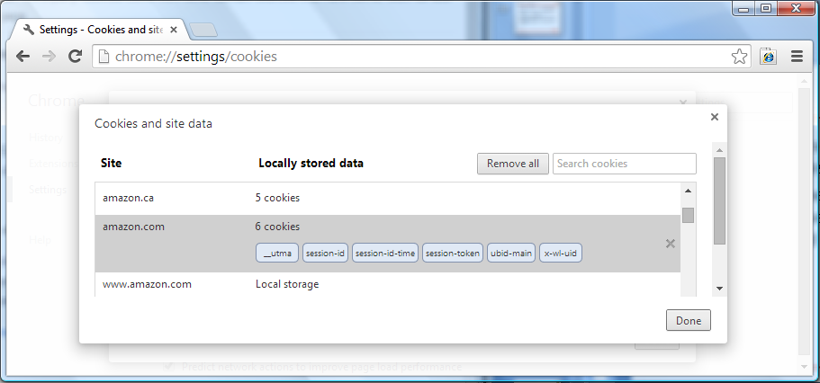
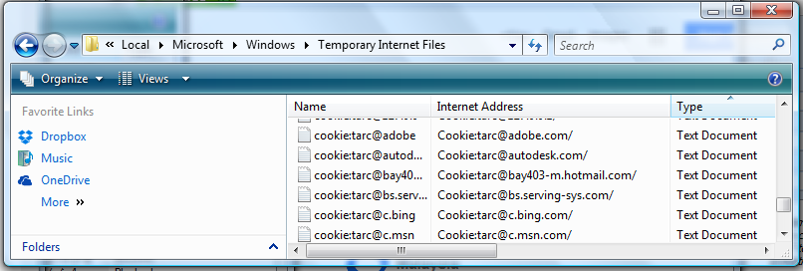
Viewing cookies from the browser
Chrome: Settings\Advanced Settings\Privacy\Content settings\All cookies and site data
internet explorer

Slide 18
Cookies
A web application sends a cookie to a browser via an HTTP response.
Then, each time the browser sends and HTTP request to the server, it attaches any cookies that are associated with that server.

Slide 19
Cookies
A session cookie is kept in the browser’s memory and exist only for the duration of the browser session.
A persistent cookie is kept on the user’s disk as a text file and is retained until the cookie’s expiration date.

Slide 20
Cookies usage
Used to store client preferences, such as:
  ____________________________
  ____________________________
Details of the last visited date and time
Some user details, such as:
  user name
  password?? (should we?)
Previous search details

Slide 21
Creating cookies
First method:
Example:
  HttpCookie identifier= new HttpCookie(CookieName);
  cookie.Value = SomeValue;
HttpCookie cookie = new HttpCookie ("LastSearch”);
cookie.Value = txtSearch.Text;

Slide 22
Creating cookies
Second method:
Example:
  HttpCookie identifier= new HttpCookie(CookieName,value);
HttpCookie cookie = new HttpCookie ("LastSearch”, txtSearch.Text);

Slide 23
Reading a cookie
Syntax:
Examples:
Request.Cookies[CookieName].Value
if(Request.Cookies[“LastSearch”] != null)
{
txtSearch.Text = Request.Cookies["LastSearch"].Value;
}
Question: Why is Line 1 (highlighted) important?

Slide 24
HttpCookie property
Expires
  A DateTime value that indicates when the cookie should expire.
Name
  The cookie’s name.
Value
  The string value assigned to the cookie.

Slide 25
HttpCookieCollection class
Cookies are managed in collection defined by the HttpCookieCollection class.
Property
  Count – The number of cookies in the collection.
Methods
  Add(cookie) – Adds a cookie to the collection.
  Clear( ) – Removes all cookies from the collection.
  Remove(name) – Removes a cookie.

Slide 26
Advantages of cookies
Since cookies persist on the client’s computer, space does not need to be allocated on the web server to store user-specific information
Cookies can save small amounts of information for very long periods of time
Cookies can be used to customize a user’s visit to your web site

Slide 27
Disadvantages of cookies
Users can choose not to accept cookies on their Web browsers (they can block the cookies)
Users can manually delete cookies
Cookies are unable to save large objects, arrays, or other complex data types. Cookies can only save string, date, or numeric data types

Slide 28
When to use cookies?
Store small piece of data that are not crucial to your application
Never use cookies to store sensitive information
Can be configured to expire after any length of time
However, cookies can be blocked at the client end.

Slide 29
Query String
Used in Anchor tags and hyperlinks (URLs) to pass information from one page to the other.
Query string syntax
  pass 1 value:
  pass >1 value
URL?name=value
Example: http://www.shop.com/shop.aspx?prod=tx0002
URL? name1=value1&name2=value2
Example: Order.aspx?cat=1&prod=tx0002

Slide 30
Passing a Query String
Example 1 (with Anchor tag)
Example 2 (with button)
Example 3 (Response.Redirect)
<a href=“product.aspx?cat=tx&prod=fog01”> Fog machine</a>
<asp:Button PostBackUrl = “shop.aspx?prod=tx0002” ID=“btnShop” runat=“server” />
  Response.Redirect(“Order.aspx?cat=“ + txtcategoryID.Text);

Slide 31
Query String
Statements that retrieve the values of the query string attributes
Example:
  The following query string is passed to “product.aspx”
  In “product.aspx”, retrieve the values
Request.QueryString[“name”]
<a href=“product.aspx?cat=tx&prod=fog01”> Fog machine</a>
  string categoryID = Request.QueryString[“cat”];
  string productID= Request.QueryString[“prod”];

Slide 32
Understanding scope
Function
  Visible within the function
Page
  Visible within the page
Session
  Visible from page to page during a session
  Session variables can be used in all the pages in an application for a particular session
Application
  Visible throughout the whole application lifetime

Slide 33
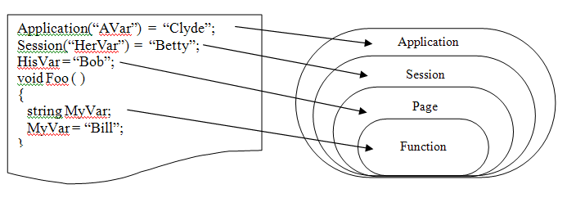
Understanding scope (cont’)

Slide 34
What is session?
Time spent browsing a site, from the moment you first start browsing to the moment you close your browser (Persists its value until a session ended or user leaves the website)
Each visitor is assigned an individual session (Data stored in session variables are not shared among different users)
A new instance of browser is considered a new session
A session object is created for each session

Slide 35
Creating session variables
Can store any type
Syntax
  Session[“ItemName”] = Content;
Examples
  Session[“username”]=“Patrick”;
  Session[“email”]=txtEmailAddress.Text;
  Session[“quantity”] = 100;
  Session[“StudentList”] = studentList;

Slide 36
Retrieving session variables
Session variable used to store objects (in any type)
Type casting is needed to assign the value of a session object to a variable.
Examples
  lblUserName.Text = Session[“username”].ToString();
  int quantity = Convert.ToInt32(Session[“quantity”]);
  List<string> studList = (List<string>)Session[“studentList”];

Slide 37
Controlling when a session ends
Default timeout – 20 minutes
Set timeout to other values by using Timeout property (in minutes)
Session.Timeout = 60; //set session timeout to 60 mins)

Slide 38
Session methods (cont’)
Add(name, value)
  Adds an item to the session state collection.
Clear( )
  Clears all values from the session but leaves the session active
Remove(name)
  Removes an item
Abandon( )
  Force to end the current session

Slide 39
When to use sessions?
Used to maintain user-specific information
Can store any variable type
Best choice when you need to maintain state only for the user’s visit to your site.
However, if you receive many concurrent users or place large object in the Session object, your Web server performance will degrade

Slide 40
Application objects
Designed to maintain state globally, across the entire website
Application variables can be accessed by all the pages and by all the users of the application
Similar to Session, it can store any data types including objects and arrays

Slide 41
Application usage
To store global application data such as discount terms and tax rates.
Display tips of the day or news update
Record the number of times a banner advertisement was clicked
Record the running count of the visitors

Slide 42
Creating application variables
Syntax
  Application[“ItemName”] = Content;
Examples
  Application[“TipsOfTheDay”]=“Failing in the past does not mean you will fail again in the future”;
  Application[“visitor”] = 0;
Can store any type

Slide 43
Retrieving application variables
Application variable used to store objects (in any type)
Type casting is needed to assign the value of a application object to a variable.
Examples
  lblDisplay.Text = Application[“TipsOfTheDay”].ToString();
  int visitorCount = (int)Application[“visitor”];

Slide 44
Application Methods
Add(name, value)
  Adds an item to the application state collection.
Clear( )
  Removes all items from the application state collection.
Remove(name)
  Removes a particular item.

Slide 45
Application Methods
Application.Lock( )
  Locks the application state collection so only the current user can access it.
Application.UnLock( )
  Unlocks the application state collection so other users can access it.
Pessimistic concurrency—when one user starts updating a record, lock it, thereby preventing any other users from editing or deleting that record until the user commits their modifications.

Slide 46
Application Property
Count
  The number of items in the application state collection.

Slide 47
Working with application events
Global.asax is a code-only file that provides event handlers for responding to application events.
Only scripts and objects are allowed
Cannot include scripts that produces output (HTML tags or Response.Write method)

Slide 48
Application events
Application_Start
  Raised when the first page of an application is requested by any user.
  Raised when web server restarted
  Raised when Global.asax file is edited
Application_End
  Raised when application is about to terminate.
Application_Error
  Raised when an unhandled error occurs

Slide 49
Application events (cont’)
Session_Start
  Raised when a user starts a session
Session_End
  Raised when a user session ends
Profile_OnMigrateAnonymous [Not covered]
  Raised when an anonymous user logs in, and allows migration of any Profile properties

Slide 50
DEMO
Application

Slide 51
When to use applications?
Used to maintain information that is global to the entire Web site.
Should NOT use to maintain state on a user-by-user basis
Can drain your server’s resources
Can’t use to store anything you need to keep

Slide 52
Caching
Caching is the process of storing frequently used data on the server to fulfill subsequent requests.
Three types of caching
  Output caching / Page output caching
  Fragment caching / Partial page caching
  Data caching [Not covered]

Slide 53
Output Caching
Allows the entire contents of a page to be persisted to memory and used to fulfill client requests.
This type of cache saves post-rendered content so it won‘t have to be regenerated again the next time it’s requested.
After a page is cached, it can be served up again when any subsequent requests are made to the server.

Slide 54
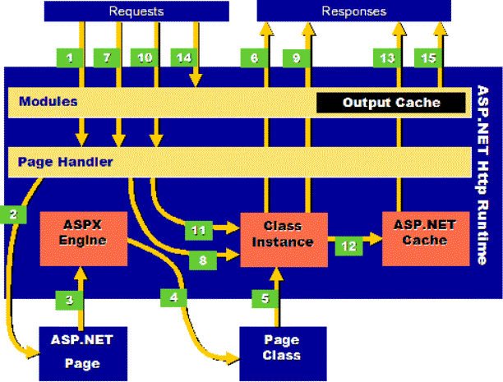
Without Cache

Slide 55
With Cache

Slide 56
Output Caching
<%@ OutputCache Duration=“60” VaryByParam=“None” %>
Duration attribute - defines the number of seconds a page is stored in the cache.
You must include either the VaryByParam attribute or the VaryByControl attribute.
However, if you do not need to vary your cached output by control or parameters, define VaryByParam =“None”.

Slide 57
Cache multiple versions of the same page in output cache
The VaryByParam attribute allows you to vary the cached output depending on the query string.
The VaryByControl attribute allows you to vary the cached output depending on a control value.

Slide 58
Cache multiple versions of the same page in output cache
The VaryByHeader attribute allows you to vary the cached output depending on the request's HTTP header.
The VaryByCustom attribute allows you to vary the cached output by browser type or by a custom string that you define.

Slide 59
Fragment Caching
Partial page caching allows parts of a page to be cached and other parts to be dynamic.
Achieved with the caching of user control.
By enabling the Shared = "true" attribute, the UserControl’s output can be shared among multiple pages and on sites

Slide 60
When to use output caching?
The generated page changes every few hours as information is loaded into a database.
When to use fragment caching?
The generated page generally stays the same, but there are several tables shown within the output that change regularly.

Slide 61
VALIDATION CONTROLS
next

